Slide 1
CS 5683: Algorithms & Methods for Big Data Analytics Fall 2020
Arunkumar Bagavathi
Department of Computer Science
Oklahoma State university

Slide 2


Little bit about myself
Ph.D. Computer Science at University of North Carolina at Charlotte
Assistant Professor in CS department at OSU
Research interests:
Data mining
Network science
Computational social science
Applied machine learning
Office: MSCS 215
Office hours: Online (by appointment only)

Slide 3
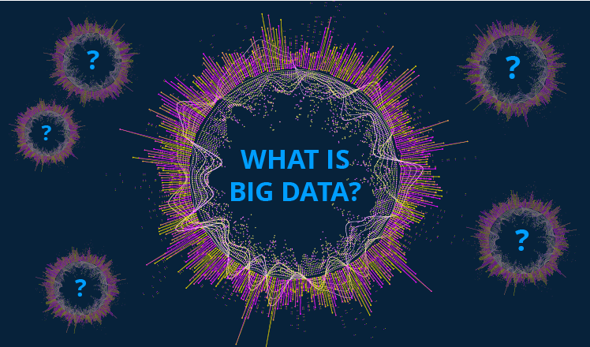

Slide 4
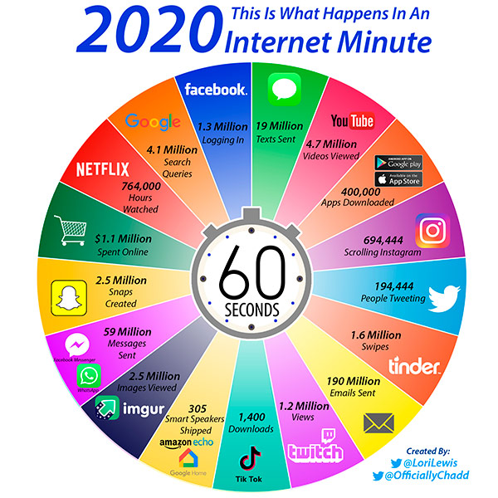
What happens in the internet in 1 minute in 2020?
Estimated amount of data in 2020:
40 trillion GB (40 zettabytes)
Note: This is the stats taken in March 2020
Source: EMC
1 zettabytes = 10²¹ bytes
How the internet is not breaking during the pandemic???

Slide 5
What is the use of such data?
Data contains valuable knowledge
Data needs to be
Stored
Managed
Analyzed
Analysis can be done with statistics, machine learning, and AI to extract knowledge
(This Class)

Slide 6
What is Data Mining?
Given: lots of data (or) big data!
Discover patterns and models that:
Useful: should handle new data
Valid: should promise some degree of certainty
Unexpected: non-obvious to humans and existing systems
Understandable: interpretable by humans

Slide 7
Data Mining Tasks
Descriptive tasks
Find human interpretable patterns that describe the data
Example: Clustering
Predictive tasks
Use some variables to predict unknown or forecast future values of other variables
Example: Classification – Recommender systems

Slide 8
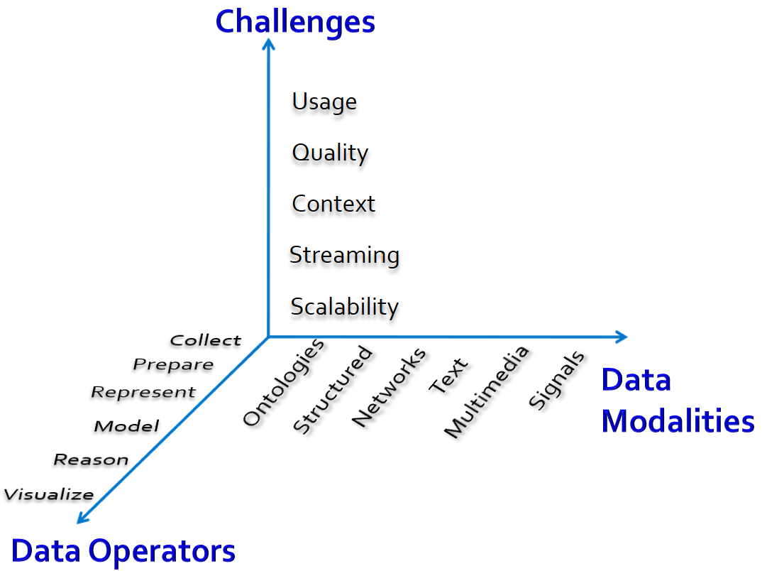
What to expect when working with Data?

Slide 9
Limits in Data Mining
If you look for too many things in big data, you will find interesting things – but do not have any significance!
Also – let’s say you are looking for a certain event!
Bonferroni’s principle: If you look for events of certain type on certain amount of random data, you always find interesting data!
– It is called Bogus
Solution: Set a threshold to avoid bogus

Slide 10
Example
Find suspicious pairs of people who atleast twice have stayed at same hotel on some two days
10⁹ people
1000 days
Each person stay 1% of time at hotel (10/1000)
10⁵ hotels
If everyone behave randomly, will data mining identify something suspicious?
Expected number of suspicious pairs of people = 250,000
Still too many people to check! We need more evidence to find suspicious people in more efficient way!

Slide 11
MORAL
DO NOT OVER DO THE DATA MINING

Slide 12
Something(s) to know!
Source: KDnuggets

Slide 13
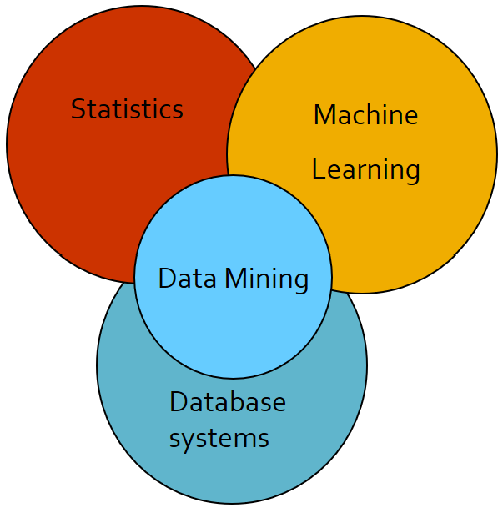
Data Mining Cultures
Data mining overlaps with:
Databases: Large scale data, simple queries
Machine Learning: Small/Medium data, complex math models
CS Theory: Algorithms
Multiple cultures:
To a DB person, data mining is a query answer
To a ML person, data mining is identifying model
parameters
In this class we will do both!

Slide 14
CS 5683
CS 5683 overlaps with machine learning, artificial intelligence, databases, and predictive analytics. But more emphasis on
Scalability
Algorithms
Handling multiple data modalities
Automation in handling big data
Application driven learning

Slide 15
What will we learn?
We will learn to mine multiple modals of data:
Data is high dimensional
Data is a graph
Data is never ending
Data is text
Data is (un)labeled
We will learn to use multiple models of computations:
Spark
Streaming and Online algorithms
Text mining algorithms
Graph mining algorithms

Slide 16
What will we learn?
We will learn to solve real-world problems:
Recommender systems
Market Basket analysis
Spam detection
Duplicate document detection
We will learn multiple methods:
Linear Algebra
Optimization
Dynamic programming
Hashing

Slide 17
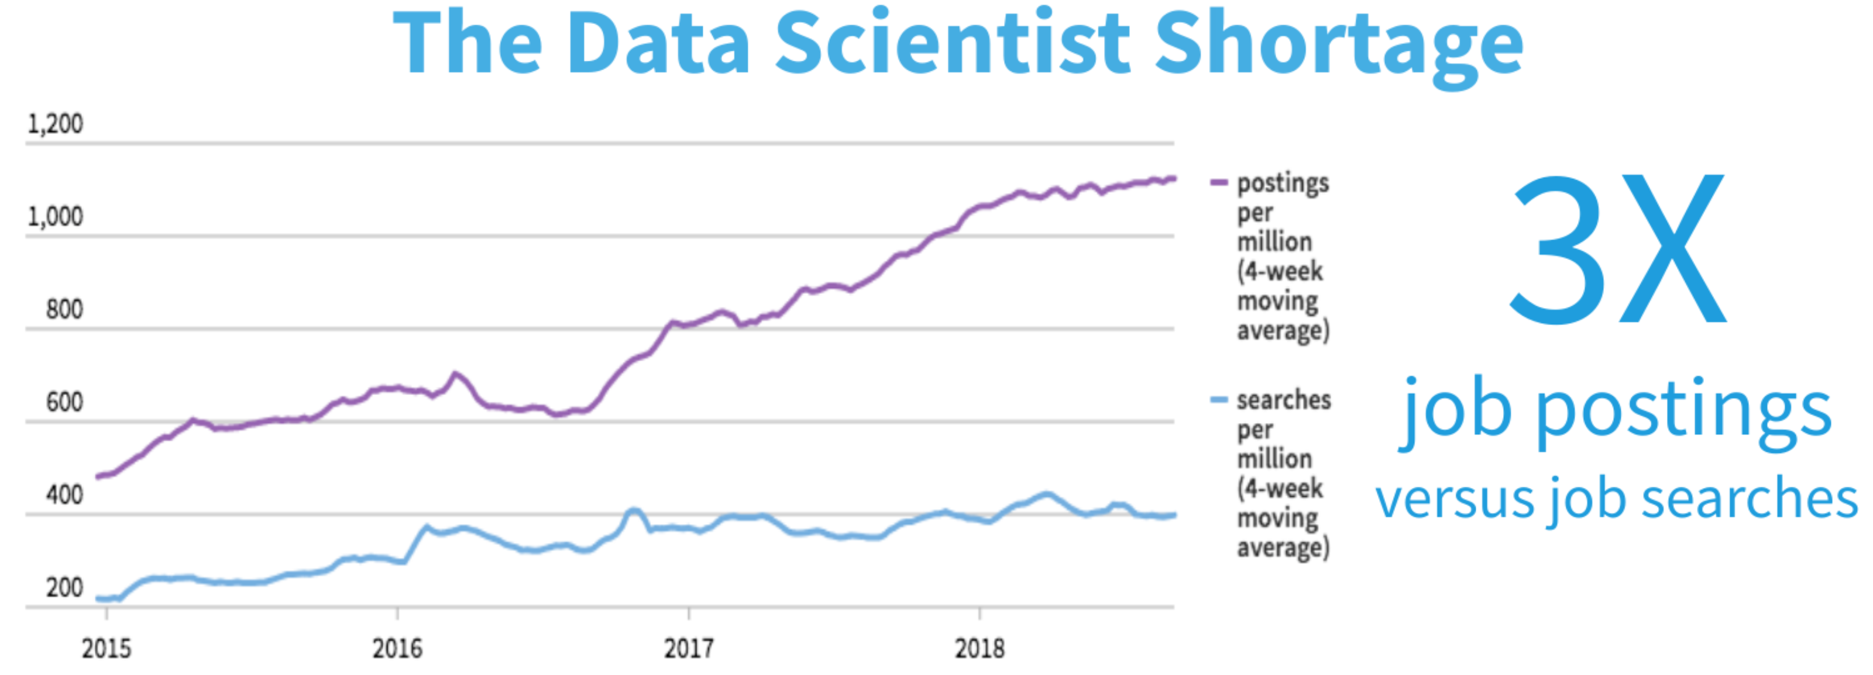
Why to learn Data Mining?
Data Engineer and Data Scientist are one of top 10 wanted jobs in industries in 2019 - https://www.businessinsider.com/best-jobs-in-america-2019-1
Demand is always high! - https://quanthub.com/data-scientist-shortage-2020/, https://www.forbes.com/sites/louiscolumbus/2017/05/13/ibm-predicts-demand-for-data-scientists-will-soar-28-by-2020/#72205c027e3b

Slide 18
About the Course

Slide 19
Teaching Assistant
We have one amazing TA!
Reza Marzban
Ph.D. student
Research interests: NLP and AI
Email: reza.marzban@okstate.edu
Arun & TA office hours: Online (By appointment only)

Slide 20
Course Prerequisites
Python programming
Data structures and algorithms
Linux environment
Probability
Linear algebra
Statistics

Slide 21

Course Activities and Grading
M.S. students:
Assignments – 25%
Projects – 50%
Final exam – 25%
Ph.D. students:
Assignments – 25%
Projects – 40%
Paper presentation – 10%
Final exam – 25%

Slide 22
Course Logistics
This course will discuss several data mining and machine learning algorithms for big data analytics: clustering, recommender systems, social media analysis, big graph mining, data stream analysis, large-scale machine learning, and online algorithms
We give hands-on experience for big data frameworks and algorithms with assignments and projects
All assignments and projects will be on PySpark and Python programming. But prior knowledge on Apache Spark is not required
May not be used for degree credit with MSIS 5683

Slide 23
Course Communication
Canvas Discussion board(s)
Post in appropriate discussion board
We have discussion board for each topic and assignment
Email us!
Expect our reply anytime within 12 hrs
Canvas Announcements
For general announcements

Slide 24
Assignments & Projects
Both are individual activities
8 – 10 assignments
small activities to get familiar with concepts
students typically will have 5 – 6 days to complete
4 – 5 projects
Data Mining (non-)programming assignments
Involves significant amount of work
Start early!
Student will have 2 – 3 weeks to complete

Slide 25
Ph.D. students Paper Presentation
Live online presentation (25-30 mins)
Overview of 2 related research papers
Papers must be related to data mining, big data, and your research area
It can be your paper too!
WHY Paper Presentation?
Advertises research among other Ph.D. and MS students
May create collaborations!

Slide 26
Assignment & Projects Submission
All submissions in Canvas
Late submissions:
2 grace periods
Including both projects and assignments
We will not accept any submissions after 1 week of the due date!
Regrading:
Email us your request!
Do not request to regrade first assignment/project at the end of the semester

Slide 27
Assignment and Project Expectations
Novelty.
https://aec.okstate.edu/sites/default/files/OSU_Academic_Integrity_Policy-May_16.pdf

Slide 28
Academic Integrity
Please review in the course syllabus
http://academicintegrity.okstate.edu
https://adminfinance.okstate.edu/site-files/documents/policies/academic-integrity-policy.pdf
In short: If you are not submitting your work, you are cheating
Consequences: Grade of ‘0’ or ‘F!’ or may even expel from the university
Notes:
F! is a grade signifying the student failed the course because of academic integrity violation

Slide 29
Diverse Technical Preparation
If your programming background in rusty, prepare in the initial weeks
Please do not ask for perfect training environment – the lecturer does not provide perfect tutorials to learn the technologies used in the course
You will encounter with:
Unclean data, unclear instructions, inaccurate documentation, etc
Start early to handle such issues
Please do not ask complex questions near the submission deadline!

Slide 30
Other University Services and Policies
Please check OSU syllabus attachment pdf

Slide 31
What’s After CS 5683?
CS 4783/5783 – Machine Learning (Fall)
CS 5433 – Big Data Management (Spring)
CS 5123 – Cloud Computing and Distributed Systems (Spring)
Independent study (3 credit hours)
Better option if you want to do a thesis
Or, explore research topics
Email instructor for more details

Slide 32
Last slide!
Follow classroom guidelines please!

Slide 33
What to do next?
How about Project-0?

Slide 34

Questions???

Slide 35
Acknowledgements
Some contents of these slides are motivated by materials from:
Dr. Srinivas Akella – UNC Charlotte
Dr. Jure Leskovec – Stanford University (http://www.mmds.org/)

